Slide 1
Welcome to State Testing Orientation
Learn what to expect before and
during the test, and ask questions

Slide 2
What to Bring On Testing Day
Water bottle with a lid
Small snack
Headphones
Book
Cell phones and other electronic devices are strictly prohibited during testing. This includes smart watches and other wifi enabled gear. These must be powered off and stored in a backpack or bag during the test.

Slide 3
When to Check in
Morning Check in Time is 8:30- 9:00 am
Morning Pick up Time is 11:30
Afternoon Check in Time is 12:30 – 1:00
Afternoon Pick Up Time is 3:30

Slide 4
How to Check In and Out
Walk with your parent or guardian to the testing site
The person signing you in will need to provide ID to the site staff member.
Students grades 9-12 may check themselves in and out with ID
The same person who signs you in, must also sign you out
If you need to have someone else pick you up other than the person who dropped you off, that must be arranged with the staff member signing you in. The name of the alternate person picking you up must match the name on that person’s ID.

Slide 5
Testing Site and Proctors
Take a moment to review the WAVA Testing Site locations. Meet your WAVA Proctors that includes teachers, counselors, administration team and staff. We look forward to seeing you at testing.
Please reach out with any questions.

Slide 6
What will the test be like?
Grades 3-8 will take Math and ELA
Grades 5, 8, and 11 will ALSO take a Science test
Grades 10 (and 11 or 12 as needed) will take Math and ELA
The Math and ELA tests have TWO parts each!
The Science test only has one part
You can only take a test in ONE subject per day!

Slide 7
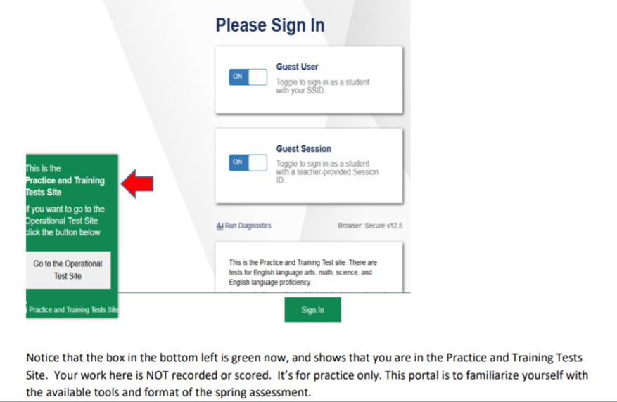
Getting ready for the test
Take the practice test!
https://login3.cambiumtds.com/student_core/V93/Pages/LoginShell.aspx?c=Washington_PT&a=student

Slide 8
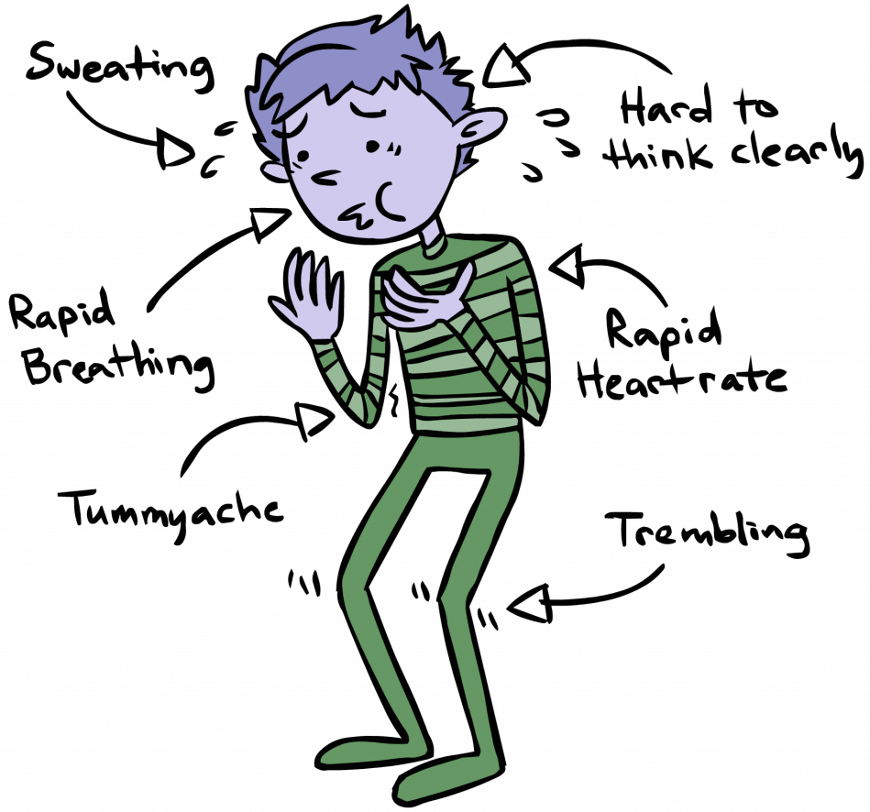
This is completely normal!
Preparation and practice will help alleviate any jitters.
Try to reframe your nervousness as excitement, because the physical symptoms are the same!
Bruh, have you even tried “box breathing”? If not, check it out!

Slide 9
Practice-practice-practice taking the Math, ELA, and Science tests! Sending a link and tutorial right now!
Enjoy a relaxing activity the night before the test and go to bed early to get plenty of rest.
Eat a healthy breakfast before testing. A well-fueled body just functions better.
Bring a water bottle and small, healthy snacks for breaks to maintain your energy.
Notes:
Link to the WCAS practice test log-in:
https://tinyurl.com/WAVA-STATE-TEST-PRACTICE
Link to Mr. Winslow’s tour of the SBA (CAT and PT) and WCAS practice site:
https://tinyurl.com/WAVA-State-Test-Practice-Guide

Slide 10
Bring gum and chew it quietly. Science reports that it helps with concentration and focus.
Read each question carefully.
Ask for help if you don’t understand the directions.
Try answering the question to yourself BEFORE reading the possible answers; then try to find your answer. Trust your gut!
Consider ALL the possible answer choices before marking your final answer.
Double-check your answers if you finish early.
Getting nervous? Try “box-breathing” like a Navy Seal! Don’t know what this is? Check it out!
Notes:
Link to the WCAS

Slide 11
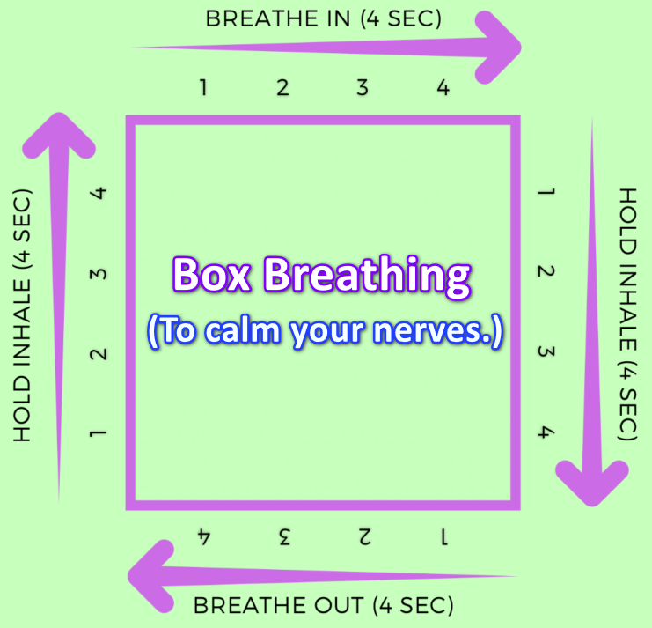
Practice “Box Breathing” through your nose to calm your mind and nerves. With enough practice before test day, you’ll be able to do it during the test without anyone noticing!
This is the same technique used by our US Special Forces to calm down and focus; so if it works for them, it’ll work for you! Talk to your parents before practicing breath-work.

Slide 12
No worries . . .
Put on your favorite
comfy outfit and enjoy showing
what you know.
Notes:
Share practice problems in-class, or
Walk through WCAS practice-test

